Slide 1
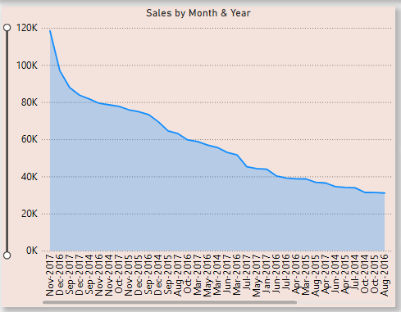
Line Chart: Chart Purpose: To observe how sales changed over time.
Findings:
Sales saw consistent growth from early 2015 to the end of 2017.
November 2017 recorded the highest monthly sales: ₹1,18,447.82.
Other high-performing months include October 2017 (₹77,776.92) and December 2017 (₹83,829.31) — showing a year-end boost, likely due to festive season demand.
Mid-year months (like May, June) consistently showed lower performance across years.

Slide 2
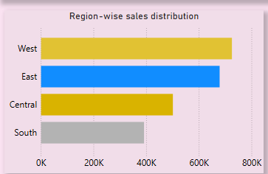
Bar Chart Analysis: Sales by Region:
Chart Purpose: To compare total sales across different geographic regions.
Findings:
West Region had the highest total sales: ₹7,25,457.82, followed closely by East (₹6,78,781.24).
South Region had the lowest performance: ₹3,91,721.91.
Regional sales distribution indicates that marketing or logistical advantages may exist in the West and East zones.

Slide 3
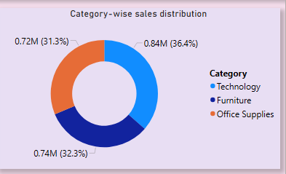
Donut Chart Analysis: Sales by Category:
Chart Purpose: To understand the contribution of each product category to total sales.
Findings:
Technology category was the top contributor: ₹8,36,154.03.
Surprisingly, Furniture (₹7,41,999.80) performed better than Office Supplies (₹7,19,047.03) despite assumptions that supplies are daily essentials.
Insights from this chart can guide product focus and inventory planning.

